Slide 1


Our solution?
Our task: Find a relation between two unrelated topics

Slide 2
FallHacks 2025: PyPath
Where gaming meets education.
Daniel & Diar

Slide 3
Tech Stack
Languages, Libraries & Tools
Python | Used for handling game logic and game states, navigation
Pygame | 2D Graphics, keyboard + mouse input
NumPy | Perform array/grid calculations for optimal pathfinding
Pandas | Data handling for leaderboard
Git + Github | Used for version control

Slide 4
The Objective
Find a way to game-ify learning.

Slide 5

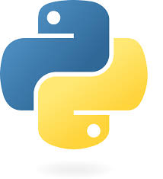
Relationship
Competition
Learning
Who can find the most effective, and efficient, solution.
vs
Teaching Python, from zero to hero.

Slide 6
How it Works:
Problem
Solution
Growth
Users are presented with a maze they must navigate using Python code.
Users compare their answer against others to get the highest score.
Improvement is imminent – driven by competition.

Slide 7
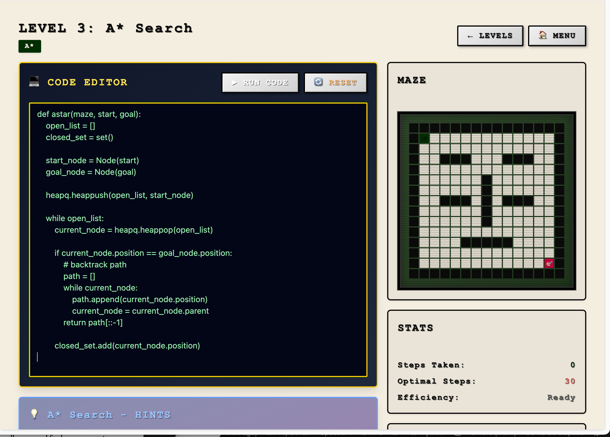
Work and Fun can exist.
PyPath is developed by users, for users. Inspired by our own struggles, and designed for the younger version of all of us.

Slide 8
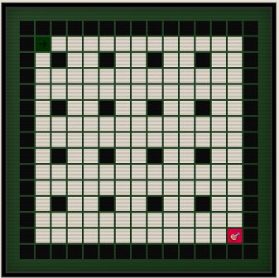
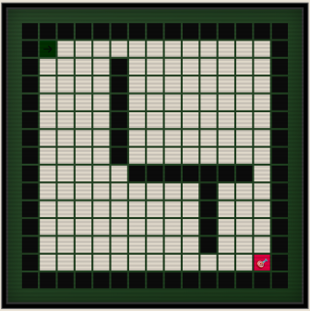
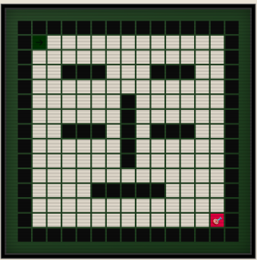
Features of PyPath:
Graph Representation
Unique mazes are built using Pygame, and displayed to users.

Slide 9
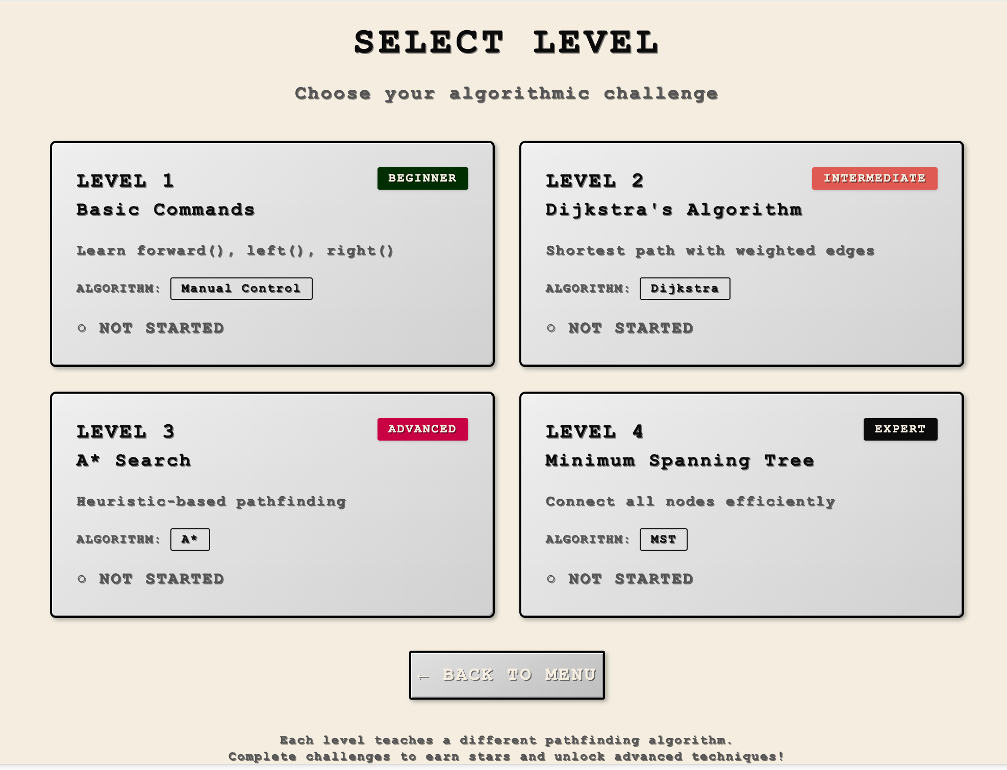
Features of PyPath (cont…):
For all levels
Various difficulty levels cater to the high school hobbyist, or the senior dev.

Slide 10
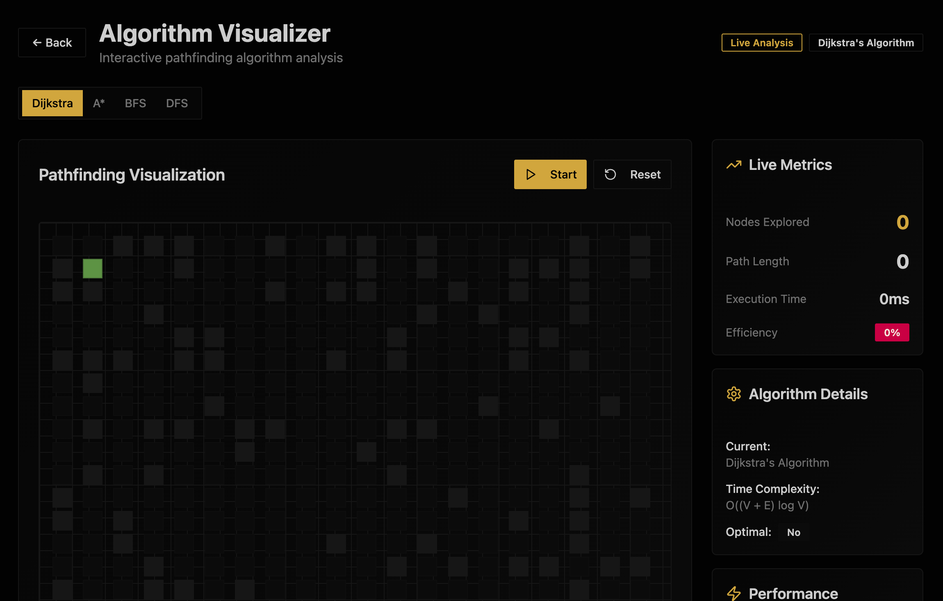
Features of PyPath (cont…):
Algorithm
Visualizer
Explore various solutions to the “maze of the day” using an array of searching algorithms.

Slide 11
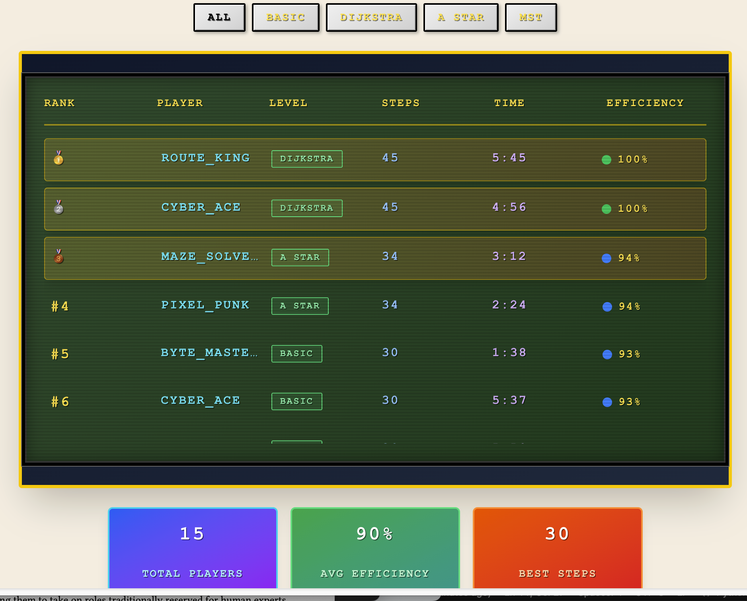
Features of PyPath (cont…):
Leaderboard
User’s scores are compiled and compared in a global leaderboard.

Slide 12
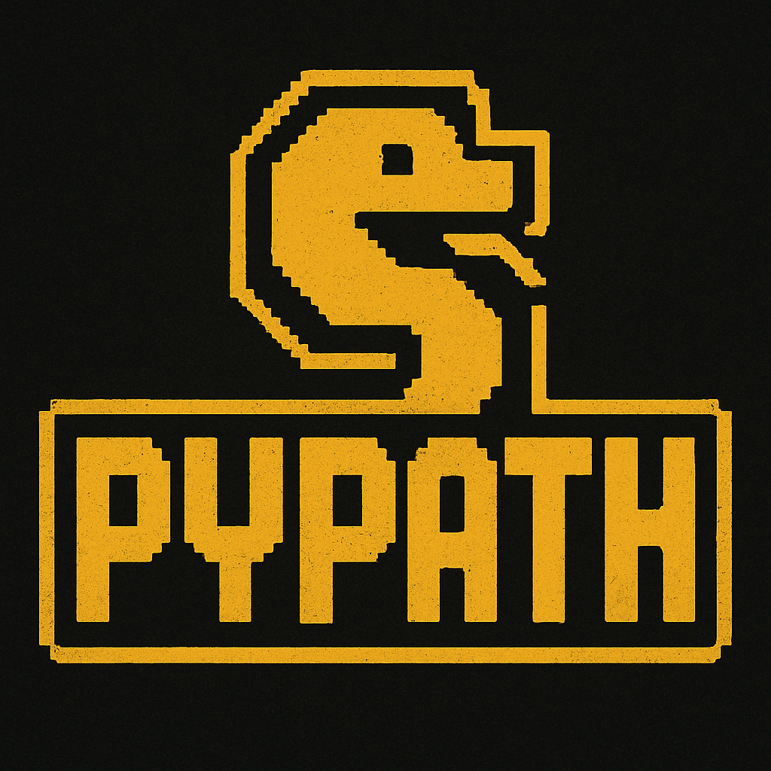
Where gaming meets education.

